Slide 1







Future Tech Review
IBM DATA ANALYST CAPSTONE PROJECT
BY
IGEMHOKHAI SHEDRACH
2022-08-11

Slide 2



OUTLINE
Executive Summary
Introduction
Methodology
Results
Visualization – Charts
Dashboard
Discussion
Findings & Implications
Conclusion
Appendix

Slide 3

EXECUTIVE SUMMARY
The most popular technologies are web-based one such as JavaScript, HTML.
Among all web-based frame works, the hottest areas area React.js and jQuery.
Windows and Linux still dominate all developing platforms.
For mobile platform, Android wins by no contest.
Although MySQL is still the most used database, MongoDB and PostgreSQL show increasing trend of applying in the future.

Slide 4

INTRODUCTION
The technology market changes quickly every year.
It is important to catch-up with the latest technology in each field.
The comparison between current & next year technology trend will provide great inside into the market.
The study consist of 4 main parts:
Top languages used.
Top databases used.
Top platforms used.
Top web frames used.

Slide 5

METHODOLOGY
The technology trend is studied, by comparing current and future technology usage.
The data was from the ‘Stack Overflow Developer Survey 2019’.
Different type of charts, such as bar, line, pie, tree-map … will be used to visualize the result.
The IBM dashboard was used to analyses data and create visualization.

Slide 6

RESULTS
The results consists of 4 main parts:
Programming languages trend
Databases trend
Platforms trend
Web frames trend

Slide 7
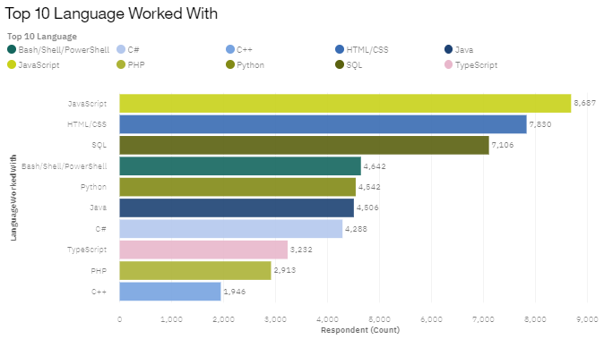
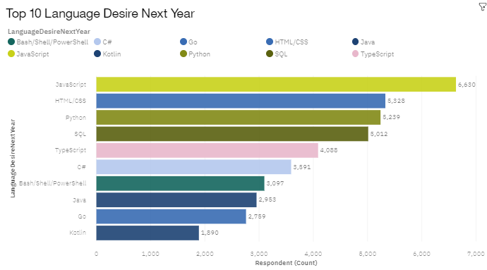
PROGRAMMING LANGUAGE TRENDS
Current Year
Next Year

Slide 8
PROGRAMMING LANGUAGE TRENDS - FINDINGS & IMPLICATIONS
FINDINGS | IMPLICATIONS
JavaScript & HTML/CSS are top programming languages for both current and future trend. | Web programming languages will still stay dominant in the near future.
Python moves from 5th position in current languages used, to 3rd position in top 10 of preferred future programming languages. . | Python & Data science is becoming more and more important.
C++ and PHP area disappearing from top 10 | Legacy language such as C++, PHP are gradually falling out of interest.

Slide 9
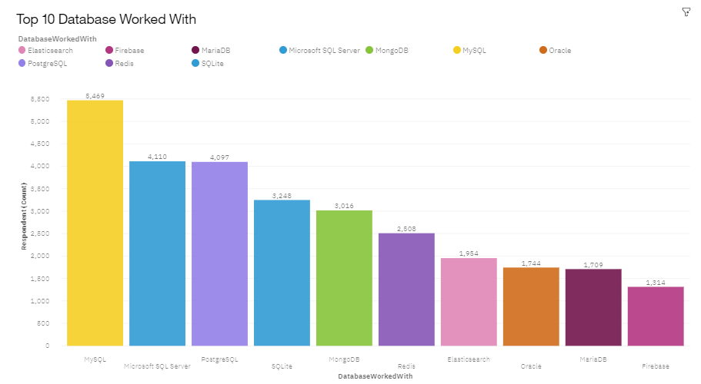
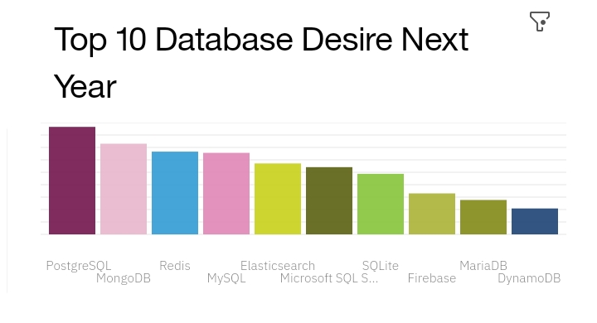
DATABASE TRENDS
Current Year
Next Year

Slide 10
DATABASE TRENDS - FINDINGS & IMPLICATIONS
FINDINGS | IMPLICATIONS
MongoDB & Redis are becoming of more interest to Database Users, while PostgreSQL moves to top. | Open source database becomes more and more popular compared with commercial one. Web programming languages will still stay dominant in the near future.
PostgreSQL moves from third on current used database to top most preferred database in the foreseeable future. | Relational database still takes a leading position in the near future.
Oracle disappear from top most preferred database for the following year. | The Emergence of open source databases like MongoDB & Redis is resulting in Oracle losing Market Share.

Slide 11
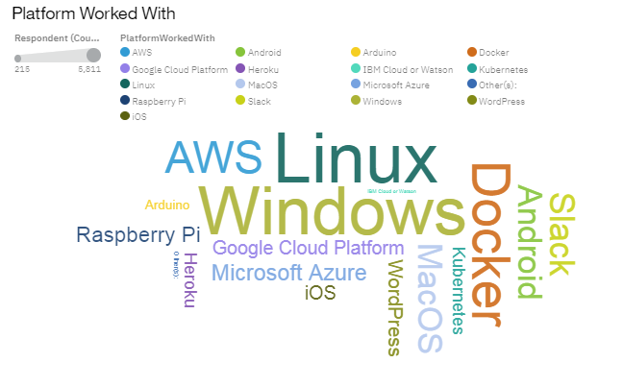
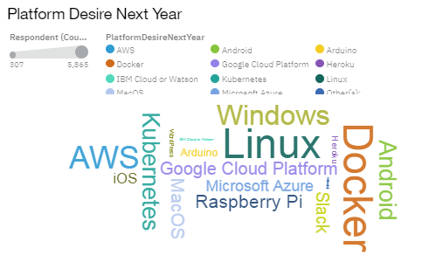
PLATFORM TRENDS
Current Year
Next Year

Slide 12
PLATFORM TRENDS - FINDINGS & IMPLICATIONS
FINDINGS | IMPLICATIONS
Windows and Linux still dominates the platform trend | Windows and Linux are still main developing platform in a foreseeable future.
Cloud platform such as Kubernetes, Docker, AWS is getting more and more market share. | The transformation to cloud computing is becoming very imperative.
Android remains number one Mobile Platform. | Android still remains most popular due to its ease of usage, and affordability.

Slide 13
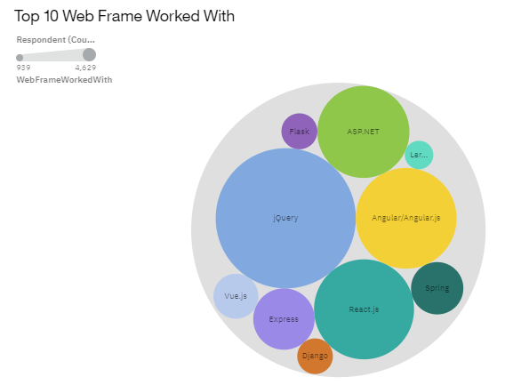
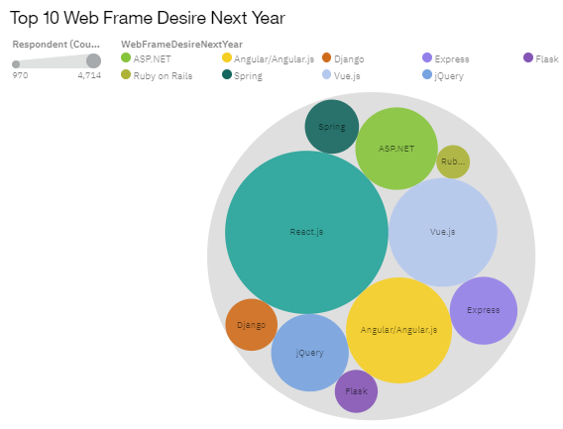
WEB FRAME TRENDS
Current Year
Next Year

Slide 14
WEB FRAME TRENDS - FINDINGS & IMPLICATIONS
FINDINGS | IMPLICATIONS
jQuery moves down from the very top spot of currently used web frames to number 4 of web frames preferred in a foreseeable future. | jQuery quickly loses market share due to lack of interest in its future development.
React.js moves up from No.3 in current top ten used web frames to top spot in most preferred in the following year while Vue.js moves from No.9 to No.3. | React.js and Vue.js becomes the new standard frameworks for web frame development

Slide 15
DASHBOARD
https://dataplatform.cloud.ibm.com/dashboards/3a86d8bc-a3d3-427f-b62f-5e6452da52f1/view/4729d72b109f1ce477d5b5e4079e25557466240cbbbb8702d1837b490d637197f03b1697c8791f088f16076bf5e5115b9f

Slide 16
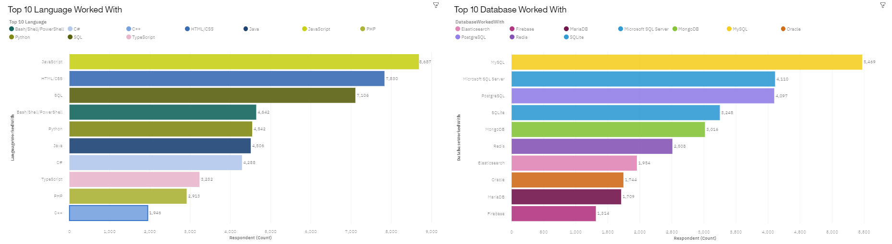
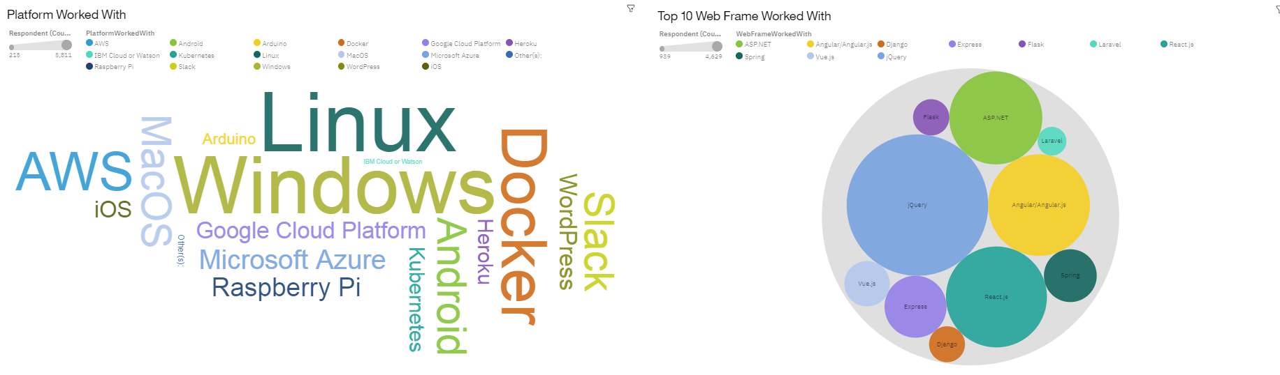
DASHBOARD TAB 1(Current Technology usage)

Slide 17
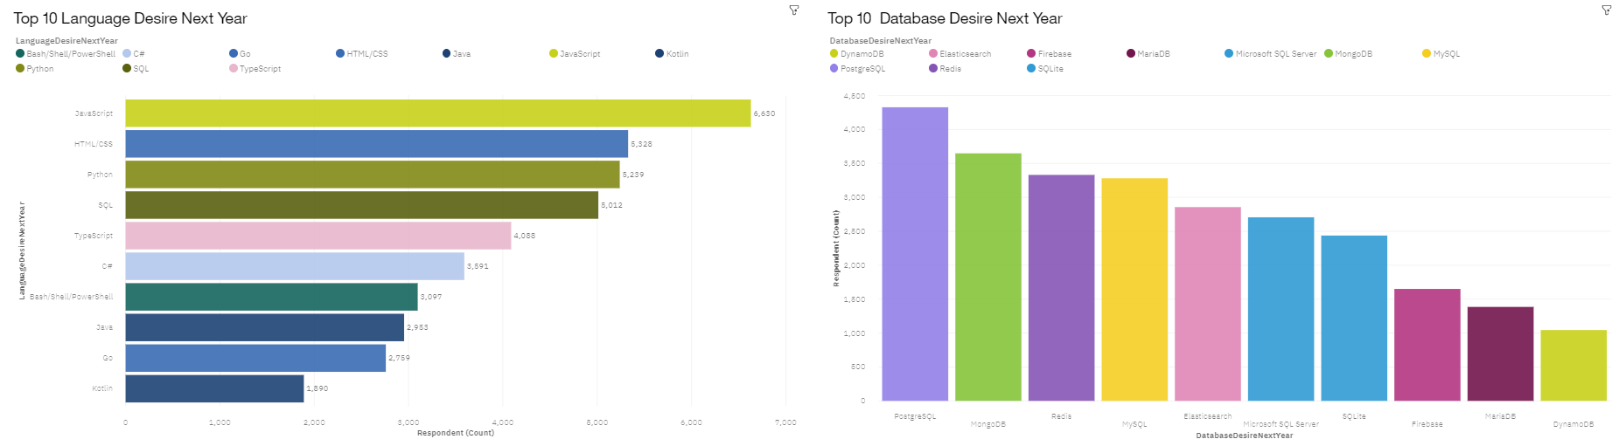
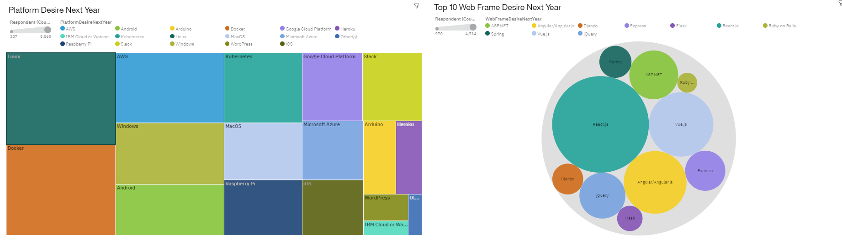
DASHBOARD TAB 2(Future technology trend)

Slide 18
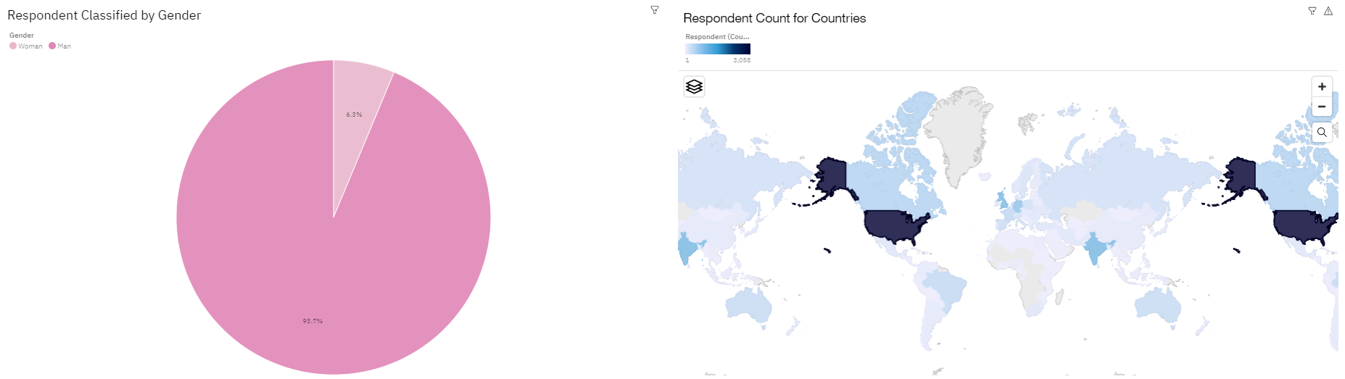
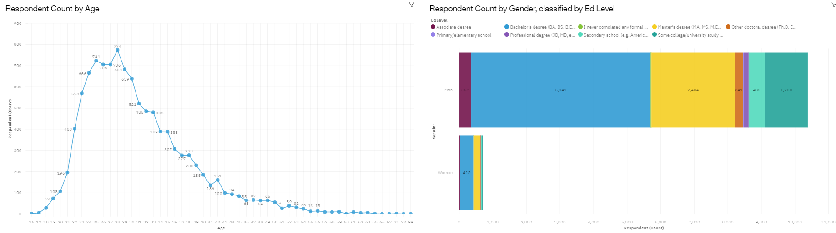
DASHBOARD TAB 3(Demographics)

Slide 19
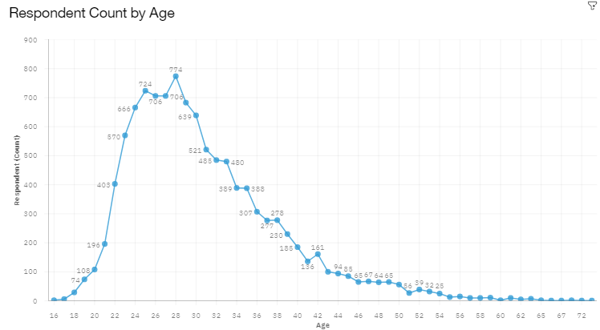
DISCUSSION
Majority of respondents are at young age (20, 30s) ➔ this could skew the result in favor of new technology.

Slide 20
OVERALL FINDINGS & IMPLICATIONS
FINDINGS | IMPLICATIONS
Web based languages remains on top. | Web based application is taking over the traditional applications.
Non-relational database takes top usage preference trend. | Non-relational database increasingly becomes the database of choice.
Cloud-based platform moves to top spot. | Cloud-based services become top-choice for platform development.
React.js stays remains top on web frameworks. | The development of React.js is still of great interest to web developers.

Slide 21

CONCLUSION
To stay relevant in the technology field, it’s important to learn web-based language & non-relational database.
Among web framework, React.js is the best to learn for your future.
Cloud-based service is the right direction for IT investment.

Slide 22

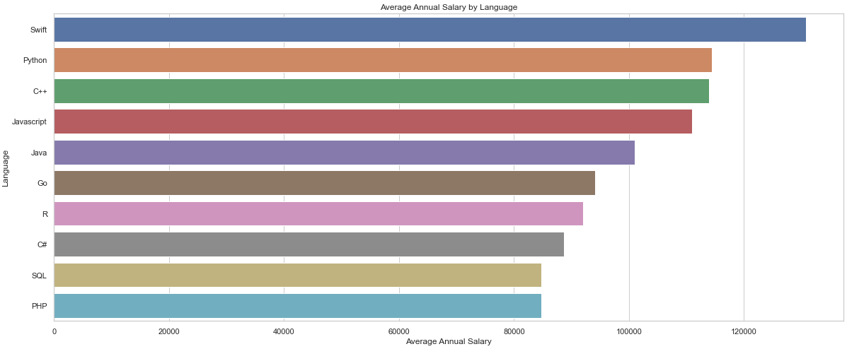
APPENDIX

